Slide 1
Personal Knowledge Engine
By the Personal Knowledge Engineers; Dec. 2, 2021
Team members:
Weston Cook - Product Owner
Cole Anderson
Noah Cantwell
Rodger Wang
Anupreet Singh
Jason Zheng

Slide 2
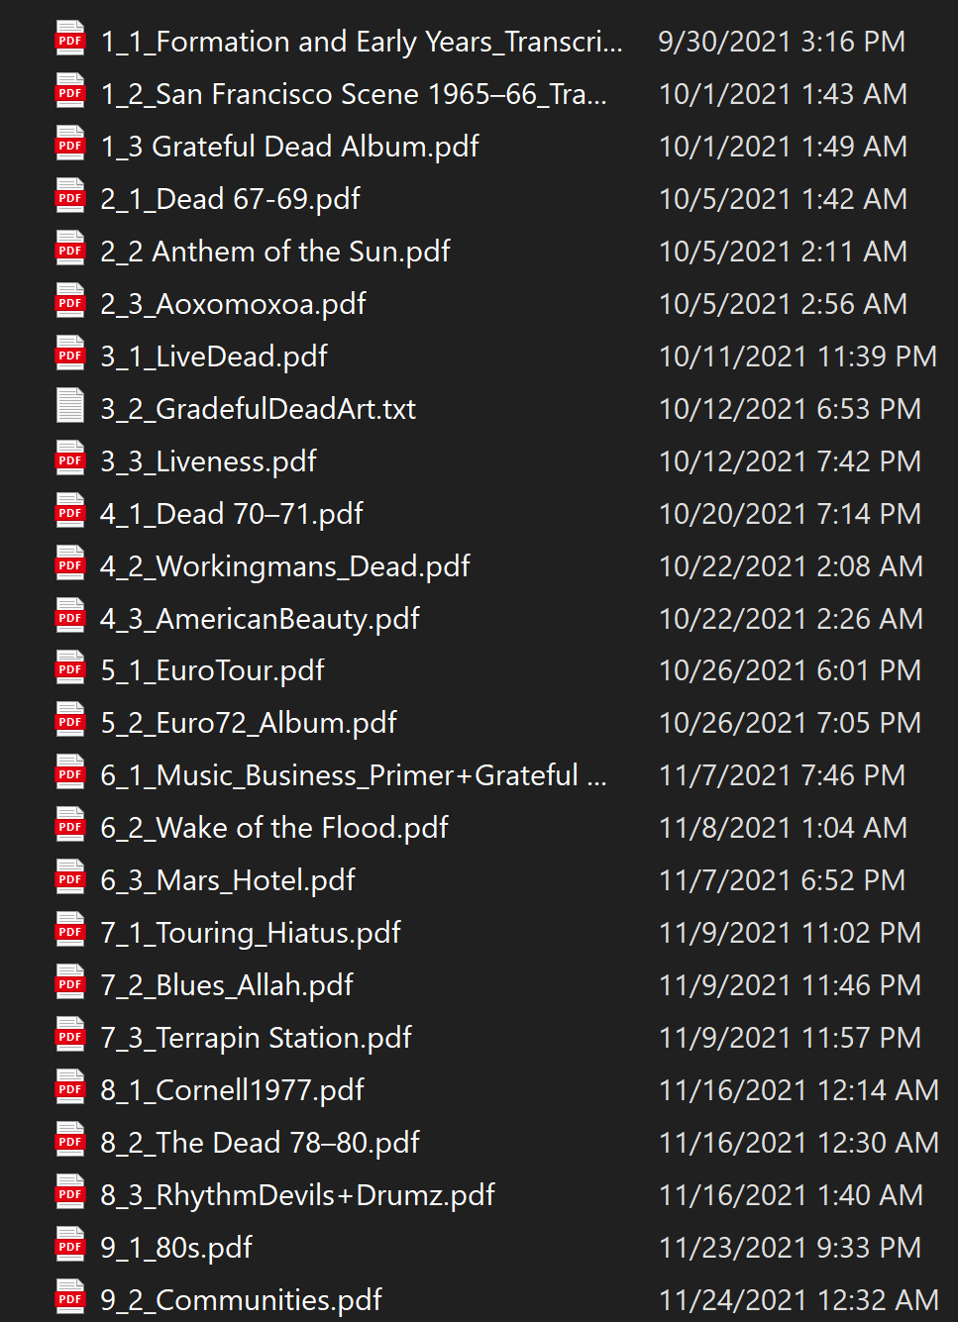
The problem:
As students, I’m sure we’ve all seen folders like this. Whether it’s notes, or lecture slides, or code, sometimes there is just too much information to parse through.
If I’m just looking for one specific term or reference, I don’t want to have to manually search all my files.

Slide 3
What is Personal Knowledge Engine?
What makes it special?
Who should use it?
Personal Knowledge Engine (PKE) is a program that is an alternative to the Windows File Search or to Apple’s Finder.
PKE offers advanced search functionality not found in default file search systems, and also has the critical benefit of searching beyond just the file name.
While this project was inspired by the vast amount of digital notes that many students have created during the pandemic, it is intended to be useful to anybody with large amounts of files.

Slide 4
Project Goals:
While file search has a simple foundation, we found that many useful features could be added on top of this simple software idea. Unfortunately, some of these ideas proved to be too complex to implement in the given time.
Key Goals:
Search File For String And Display Search Hits
Clean, Useful GUI
Search Whole Directories
Natural Language Processing
OCR Image Search

Slide 5


Slide 6
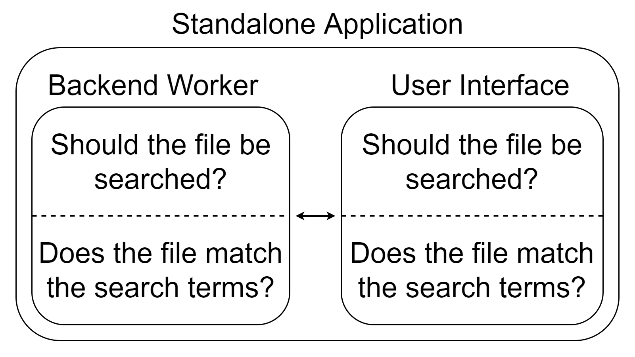
Architecture

Slide 7


Technologies Used
Backend: PyQt5
Popular GUI model
Works on Windows, Mac, Unix
Python
Versatile
Already known by all group members

Slide 8
Challenges
Group management
Represented a new and unfamiliar style of work compared to most of our other coding and project based classes.
Collaborative coding
While many of us have coded collaboratively in the past, the new and specific structure for this collaboration was at times challenging.
New technology
This project required the learning of some new and unfamiliar technologies and libraries to create an effective project, which could be confusing at times. Some of the stretch goals had such complex technology that the goal had to be removed from the project.

Slide 9
Achievements
The project was completed!
Group collaboration and specialization
By the end of the project, group members had all contributed in valuable ways to the code, and had each developed one or more area of specialization or knowledge within our large project.
Management streamlining
Over each sprint, we improved our ability to stay on task and get work done at a reasonable rate, meaning that while the first few sprints could be painful and confusing, the final sprints were straightforward and understood by all.

Slide 10
Project Management Techniques
Project management techniques were all based on Scrum, with some minor subtractions either made due to oversight or due to restrictions from this class. We also added some components to our Scrum to aid with productivity.
Standups were held three times a week
Standups weren’t time boxed during early sprints
Scrum masters didn’t always exercise their authority over the group, leading to standups that were more group-driven discussions.
An addition to Scrum was source control, including branching and merging

Slide 11
Successes/Frustrations
Successes
Collaborating to get software components functioning
Creating a usable final product
Learning how to utilize unfamiliar software technologies/libraries
Frustrations
Scheduling (People missing meetings)
Code interference when multiple people work on the same code
Having code done in a timely manner

Slide 12
Lessons Learned
What Worked / What We Will Keep Doing:
Reaching out for help from one another when stuck or struggling to meet deadlines.
Discussing progress and contributing ideas to complete certain tasks efficiently.
Required attendance to all meetings and standups.
What Didn’t Worked / What We Will Stop Doing:
Waiting on team members or certain stand ups to start working on tasks.
Using standups as a space to have one-on-one conversations with specific members rather than scheduling separate meetings.
Discussing issues towards the end of a sprint rather than as issues arise, preventing quicker resolutions.

Slide 13
Lessons Learned (Continued)
Things We Wished We Had Done (Start Doing In The Future):
The team should do design mockups before a sprint, ensuring that each team member understands the product specifications and goals before coding starts.
Initially familiarizing with all aspects of the project, each member should have had some contribution or familiarity with the GUI and backend so that all members could be able to work on tasks related to any file or subject matter
Meetings with specific individuals rather than the whole team for efficient and impactful discussions
Review our past burn up charts more thoroughly after they are done
Doing front end tasks in parallel with back end task rather than incrementally increasing load.

Slide 14
Thanks for Listening! :)

